Slide 1
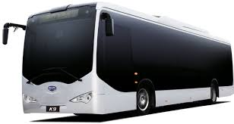
MTC’roid ROUTE MAESTRO

Slide 2
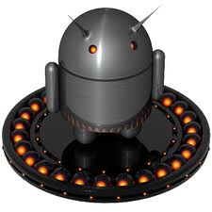
TEAM MEMBERS:
DIVYA E[50810205015]
KALAIARASI [50810205027]
NIVETHA [50810205041]
GUIDED BY:
SUNDARAPANDIYAN S
[Asst.prof/IT Department]

Slide 3
ABSTRACT
Travelling is a large growing business in various countries also.
Bus informations(fare,route,favourite places,notifications)
We can install this application in mobile.
Our project will be useful for update the route of the services .
One widely used input for mobile application is GPS(global positioning system) location.

Slide 4
INTRODUCTION
MTC is the governmental agency that operates public bus services.
It provides informations such as administration, fares, bus routes.
It also updates list of fares ,a list of termini
The numbers of bus registered to each bus and of all the buses with their starting and ending points.

Slide 5
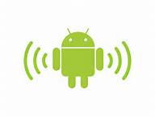
EXISTING SYSTEM
In the existing system all the jobs of the bus route management is done manually.
This is very difficult to the operators who want to handle hundreds of trips and many buses in a day.
In the current system,”Electronic Ticketing Machine” is used for calculating fare calculation

Slide 6
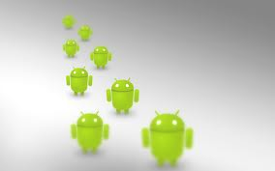
CONT…
Chennai route check :
In this application,user can get the route only by giving
the source and destination
It doesn’t connect with google map
It works both on online and also in offline
It doesn’t shows all the routes
It doesn’t provides detail information about the bus.

Slide 7
CONT…
MTC Bus:
In this application,user can get the route and
intermediate places
It connects with google map
It works only on online
It doesn’t shows all the routes
It doesn’t provides detail information about the bus

Slide 8

DRAWBACK OF EXISTING SYSTEM
In existing system there is no features of fare calculations
Internet connection is needed in the existing system
It doesn’t identify the famous places
It will not provide the notifications for destination.

Slide 9
PROPOSED SYSTEM
The proposed system is very useful for the passengers.
This avoids the overheads,stress for the mobile operators.
In this application user can calculate different categories of bus fare calculations,destination favorite place.
This project aims to use both GPS location and google maps in the development of an android application for the MTC.

Slide 10
CONTI…
GPS tracking is the method of working out exactly shows the users locations.
GPS tracking uses the Global Navigation Satellite System(GNSS)
It track the location and send notification to user who travelling in the bus.

Slide 11
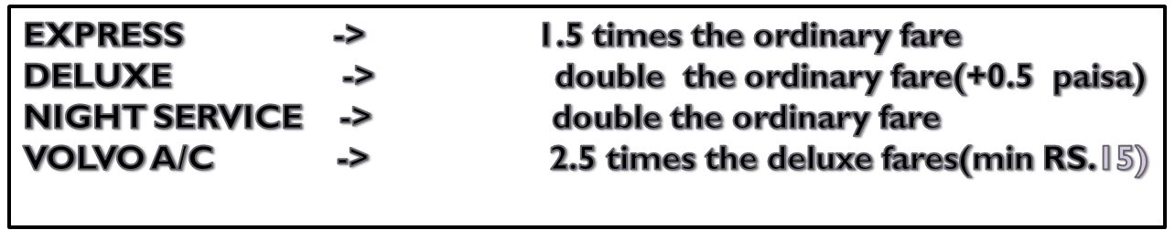
STAGE FARE[values in rupees]
stage | fare | stage | fare | stage | fare | stage | fare | stage | fare | stage | fare
1. | 3.00 | 6. | 6.00 | 11. | 8.00 | 16. | 9.00 | 21. | 11.0 | 26. | 13.0
2. | 4.00 | 7. | 6.00 | 12. | 8.00 | 17. | 9.00 | 22. | 11.0 | 27. | 14.0
3. | 5.00 | 8. | 7.00 | 13. | 9.00 | 18. | 10.0 | 23. | 12.0 | 28. | 14.0
4. | 5.00 | 9. | 7.00 | 14. | 9.00 | 19. | 10.0 | 24. | 12.0
5. | 6.00 | 10. | 8.00 | 15. | 9.00 | 20. | 10.0 | 25. | 13.0

Slide 12

ADVANTAGE
Our proposed system has several advantages:
User friendly interface
Fast access to database
More Storage Capacity
Search facility
Look and Feel Environment

Slide 13
LITERATURE SURVEY
Title GPS and GPRS Based cost Effective Human Tracking
System Using Mobile Phone.
Author Ruchika Gupta and BVR Reddy
Concept GPS Tracking
Title Electronic Ticketing machine
Author keith E.Mayes.
Concept Handheld device of BusConductor
Title ES Based Automatic ticket vending machine for modern transport system
Author M.Bhuvaneswari,S.Sukhumar
Concept Transport Details

Slide 14
MODULES
DATA COLLECTION:
This process is to extract information from the data set .
Transform it into an understandable structure for further use.
PHP SERVER:
This server retrieves the data’s from the database management system.

Slide 15
Cont…
Routes Management module:
In this module,if any routes are changed in the MTC Chennai bus service it will updates in route module.
Fare calculation:
In these module the user can see the fare for different types of buses.
Notification:
GPS tracking
LBS
Alarm

Slide 16
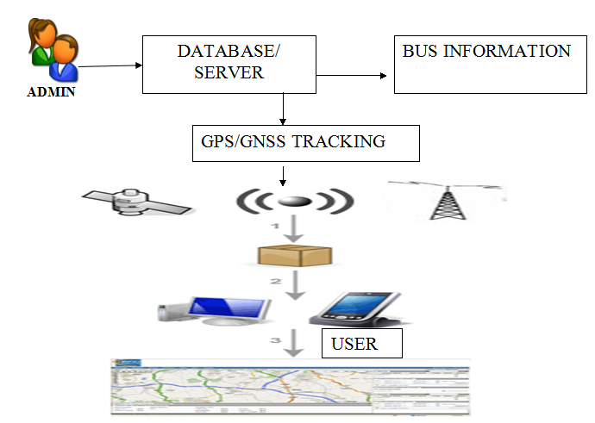
Architecture Diagram

Slide 17
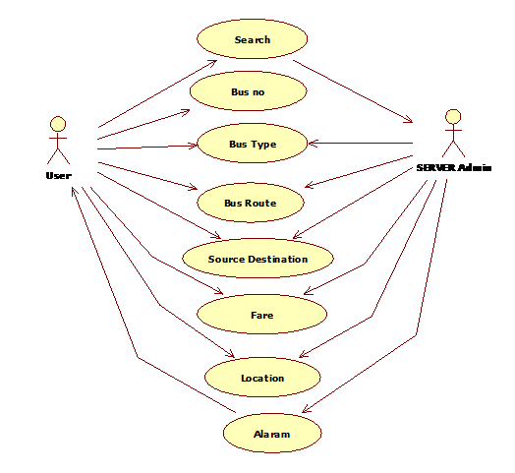
Usecase diagram

Slide 18
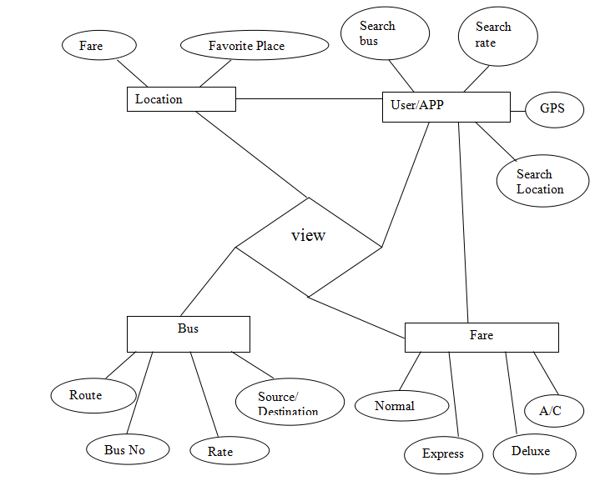

ER Diagram

Slide 19
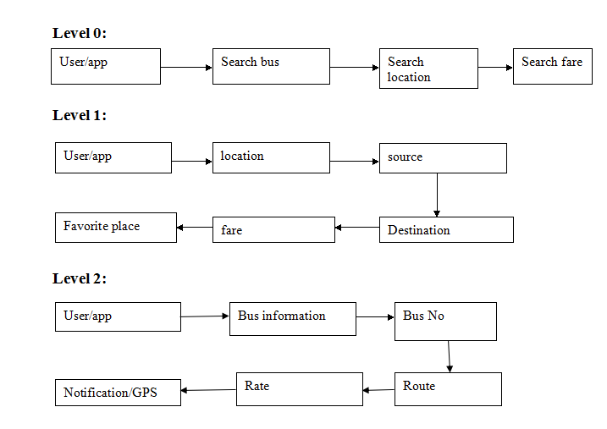
Dataflow Diagram

Slide 20
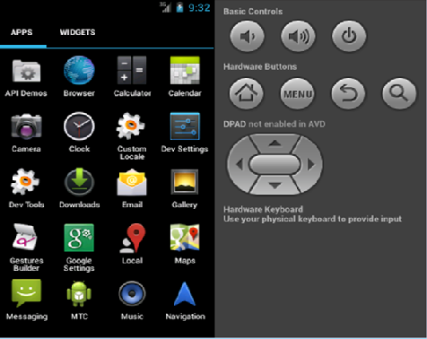
MOBILE MENU SCREEN

Slide 21
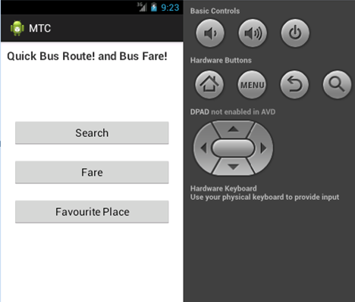
APPLICATION HOME SCREEN

Slide 22
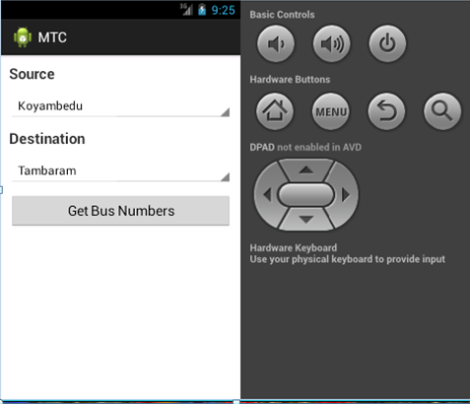
SEARCH BUS ROUTE

Slide 23
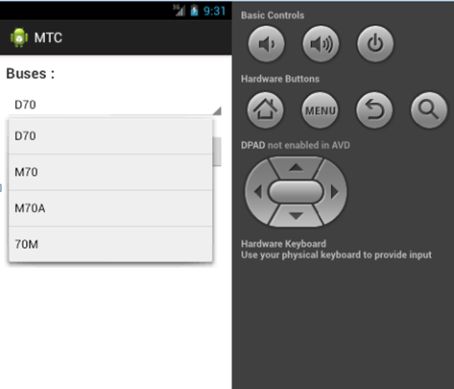
BUS LISTS

Slide 24
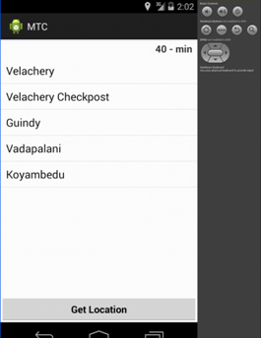
ROUTE WITH TIMING

Slide 25
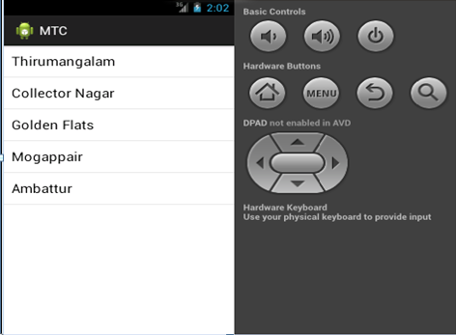
INTERMEDIATE PLACES

Slide 26
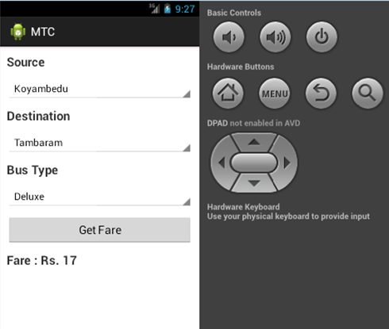
FARE CALCULATION

Slide 27
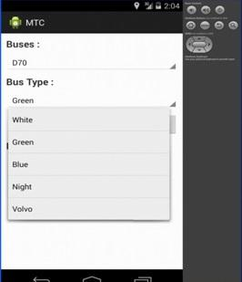
CLASSIFICATION OF BUS

Slide 28
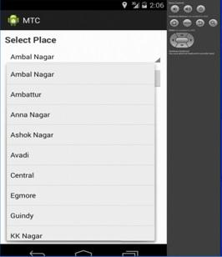
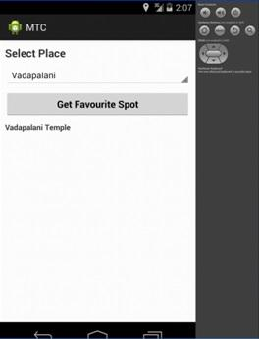
FAVOURITE PLACES

Slide 29
Fare Calculation
mGetFare.setOnClickListener(new View.OnClickListener() {
public void onClick(View arg0) {
String mBusno = arrayAdapter.getItem(mBuses.getSelectedItemPosition());
String mBustype = busAdapter.getItem(mBusType.getSelectedItemPosition());
loadCost(mSource, mDestination, mBusno, mBustype);
}

Slide 30
Favorite Place
public class DownloadWebPageTask01 extends AsyncTask<String, Void, String> {
final ProgressDialog dialog = new ProgressDialog(
FavouritePlaceActivity.this);
private volatile boolean running = true;
public DownloadWebPageTask01() {
running = true;
}

Slide 31
GPS Tracker
public GPSTracker(Context context) {
this.mContext = context;
getLocation();
}
public Location getLocation() {
try {
locationManager = (LocationManager) mContext
.getSystemService(LOCATION_SERVICE);
isGPSEnabled = locationManager.isProviderEnabled(LocationManager.GPS_PROVIDER);
isNetworkEnabled = locationManager.isProviderEnabled(LocationManager.NETWORK_PROVIDER);

Slide 32
Alarm Screen
if (gps.canGetLocation()) {
Log.d("destLat alarm screen",""+destLat);
Log.d("destLng alarm screen",""+destLng);
double latitude = gps.getLatitude();
double longitude = gps.getLongitude();
Log.d("current-Lat alarm screen",""+latitude);
Log.d("current-Lng alarm screen",""+longitude);
}

Slide 33
CONCLUSION
Android is the latest Technology, which has its own specifications and many applications for real time use.
Main reason to use the Android is “it’s a user friendly”.
Now a day’s PHP is the most securable language in Technology side.
Combination of these both platforms gives easy survey, design, implementation and finally security.
It is more useful for an exact result of transportation system, business peoples, passengers and also for tourists.

Slide 34
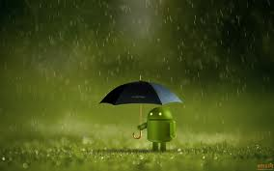
REFERENCE
1.http://en.wikipedia.org/wiki/Metropolitan_Transport_Corpoation_(chennai)
2.http://www.mtcbus.org/MTC chennai Website
3.https://play.google.com/store/search?q=chennai+MTC&c=apps(List of previously created apps)
4.http://www.livechennai.com/detailnews.asp?newsid=1609
5.http://articles.timesofindia.indiatimes.com

Slide 35


